Slide 1
London Weather Prediction
Felipe Rodriguez
Notes:
Welcome everyone to the London Weather Predcition Modeling Presentation

Slide 2


Agenda
Project Overview
Data Overview
Methods and Analysis
Challenges
Findings
Implementation
Summary
Notes:
This is the agenda for today.. We are going to be talking about..

Slide 3
Project Overview
Understand Factors that influences London weather
Build a model to predict weather in London
Understand weather trends for event bookings
Notes:
The goal of this project is to..
Ny understanding these trends the team can schedule events for clients by planning with months of anticipation and have a better idea of the weather conditions will be during the date they selected.

Slide 4
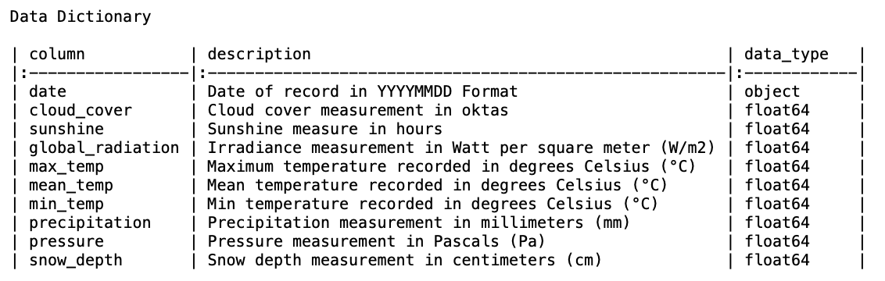
Data Overview
Historical Weather Data
Kaggle – ECA
London Data
Notes:
The data contains..
It is sourced from.. european climate assessment
And includes..
This project will analyze this weather data from London
The information you see below are the fields included in the data set.

Slide 5

Methods and Analysis
Two Models
ARIMA
SARIMA
Correlation Matrix
Time Series Graph
Density Plots
Notes:
Two models were created and were split 80/20 into a testing and training data set.
Additionally, we created a correlation matrix to understand the fields in the data.

Slide 6
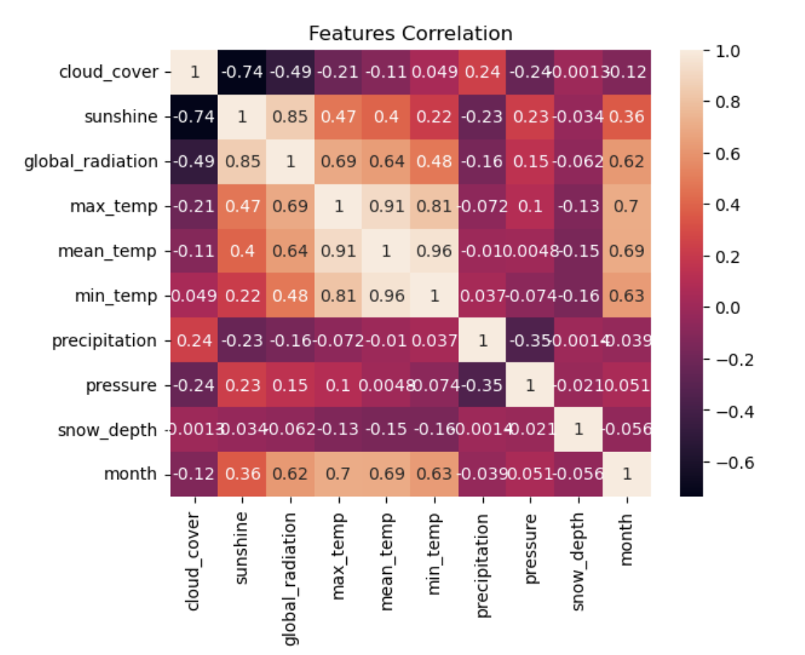
Findings
Months played a role in mean temp but not in precipitation or snow depth
Cloud cover and precipitation positively corelated
Notes:
Months played..
As we see in the values..
closer to 1 indicates a high correlation

Slide 7
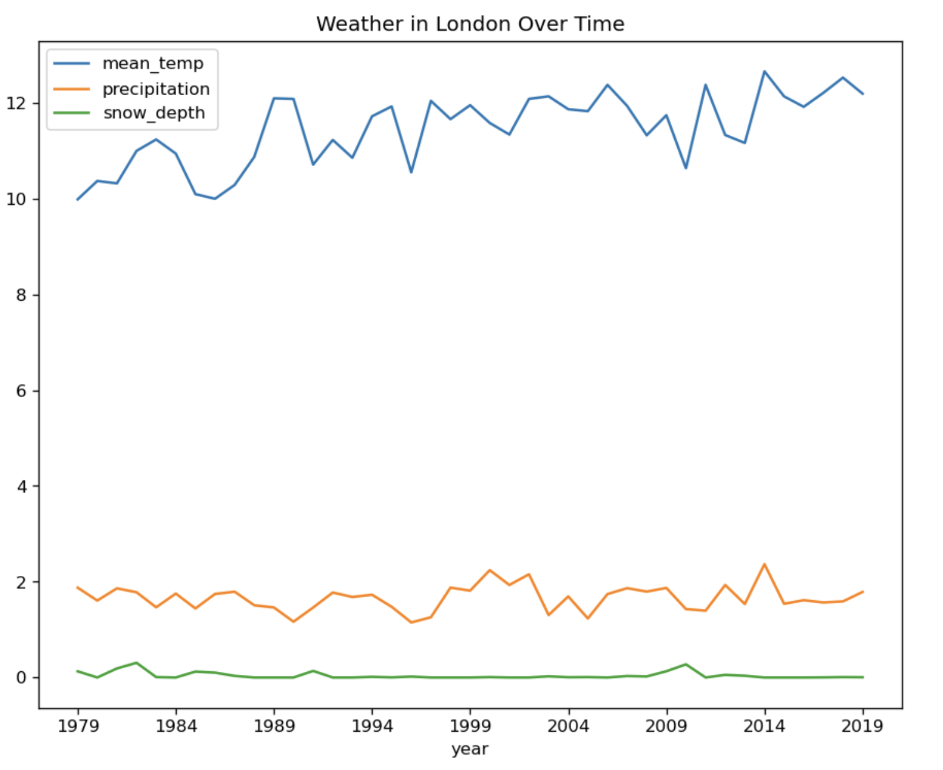
Findings
Mean temp has been increasing
Precipitation changes over time
Snow depth remains unchanged

Slide 8
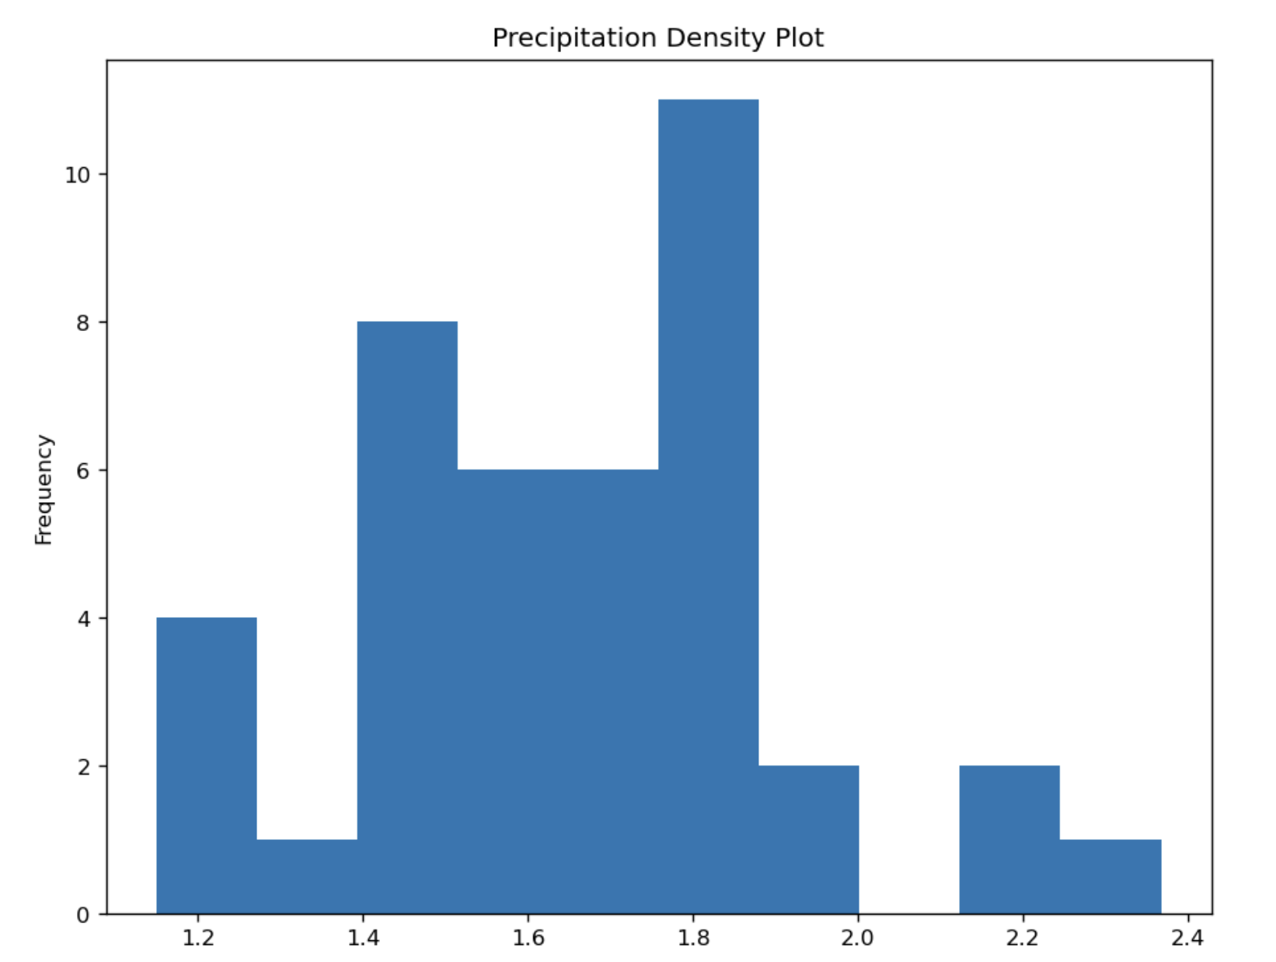
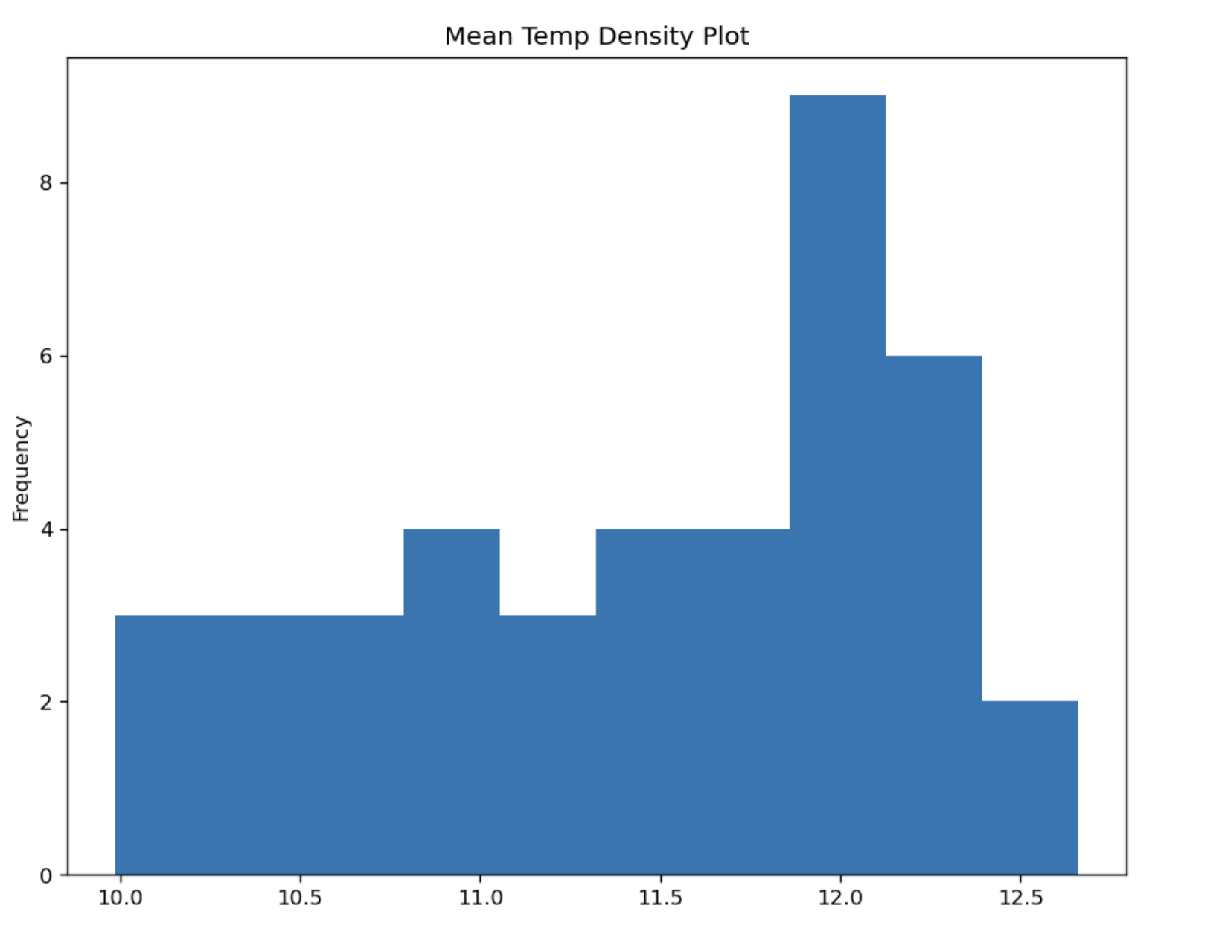
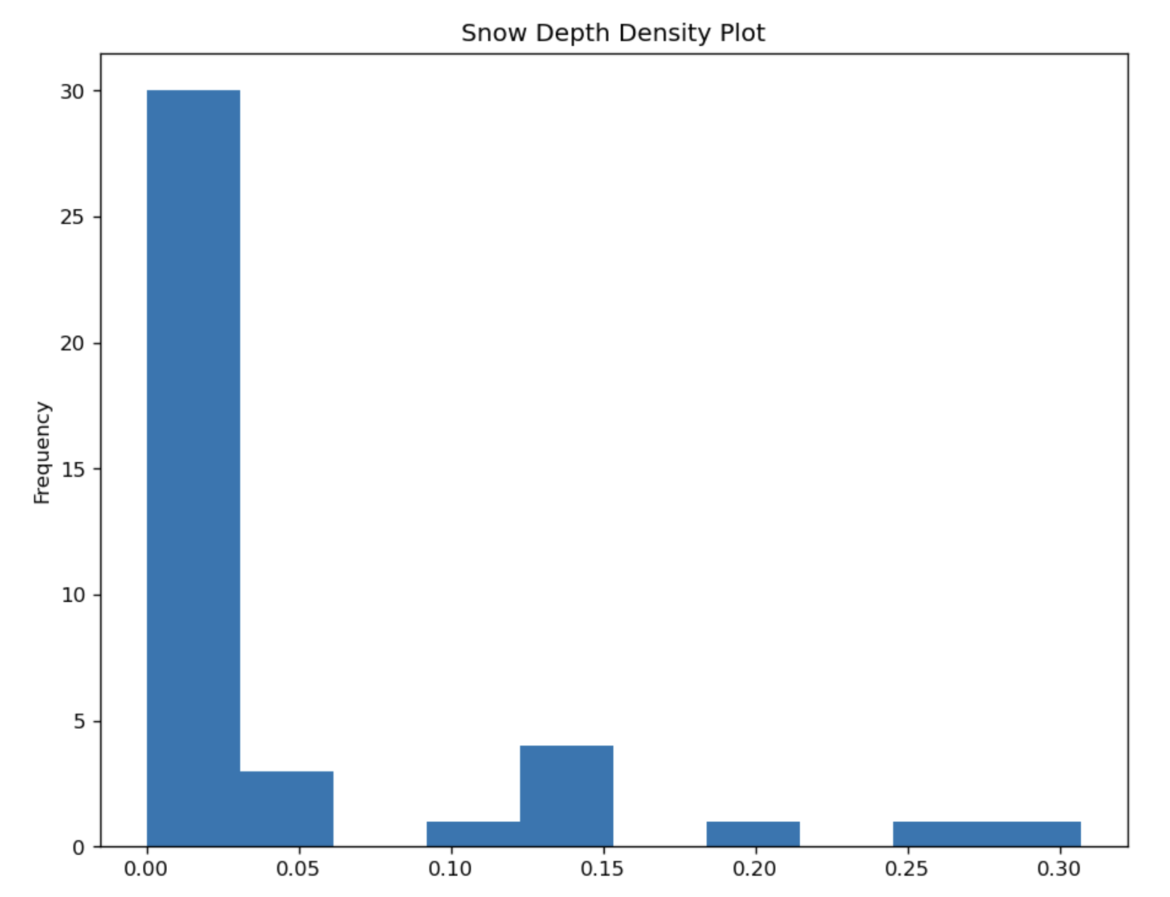
Findings
Mean Temp has similar frequencies
Precipitation does not have a normal distribution
Snow depth is skewed to the right

Slide 9
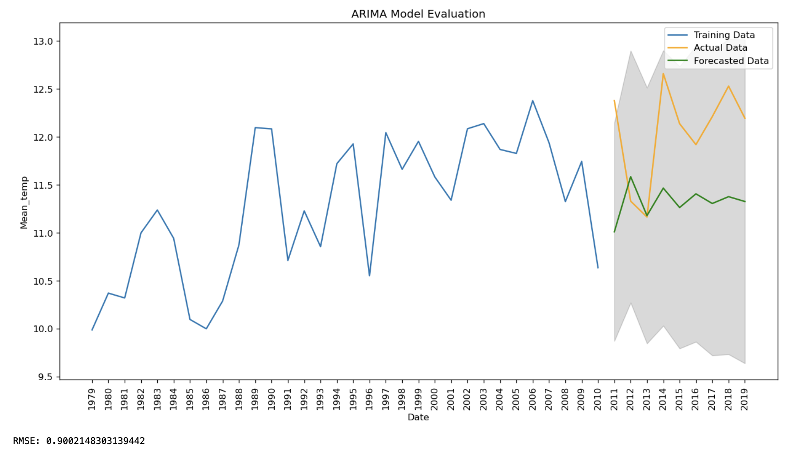
Findings
ARIMA Performed Well for Mean Temp
ARIMA and SARIMA did not perform well for Precipitation and Snow Depth
Mean Temp RSME : 0.90
Precipitation: ARIMA 0.30, SARIMA 0.22
Snow Depth: ARIMA .10, SARIMA 0.12

Slide 10
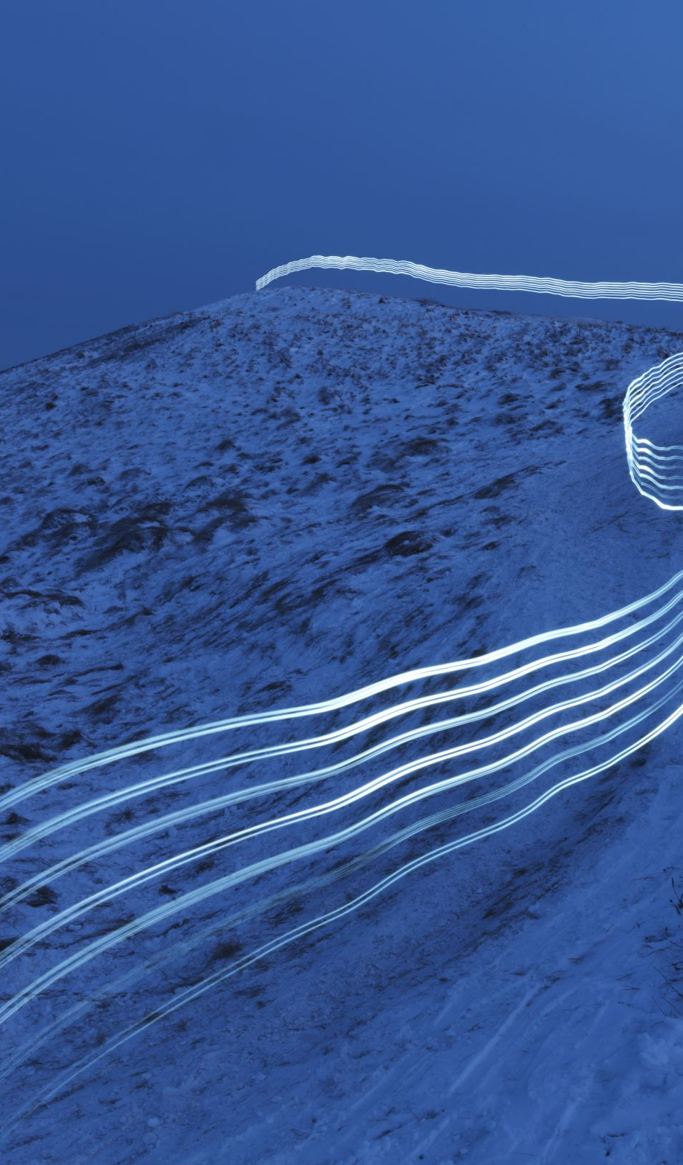
Challenges
Precipitation and Snow Depth Performed Poorly
Distribution Plots provide insight
Adjusting for seasonality did not improve the model performance

Slide 11

Implementation
Web App
StreamLit
CSVs of Model
Users can input dates, and the Web App will return prediction

Slide 12
Summary
ARIMA
High Accuracy For Mean Temp
Factors that influence Mean Temp
Month
Implementation plan
Recommendation
Precipitation and Snow Depth to be analyzed further with another model
Awaiting Approval

